Slide 1

Clustering Methods
Dr. Shahid Mahmood Awan
http://turing.cs.pub.ro/mas_11
curs.cs.pub.ro
shahid.awan@umt.edu.pk
University of Management and Technology

Slide 2
Cluster Analysis: Basic Concepts and Methods
Cluster Analysis: Basic Concepts
Partitioning Methods
Hierarchical Methods
Density-Based Methods
Grid-Based Methods
Evaluation of Clustering
Summary

Slide 3
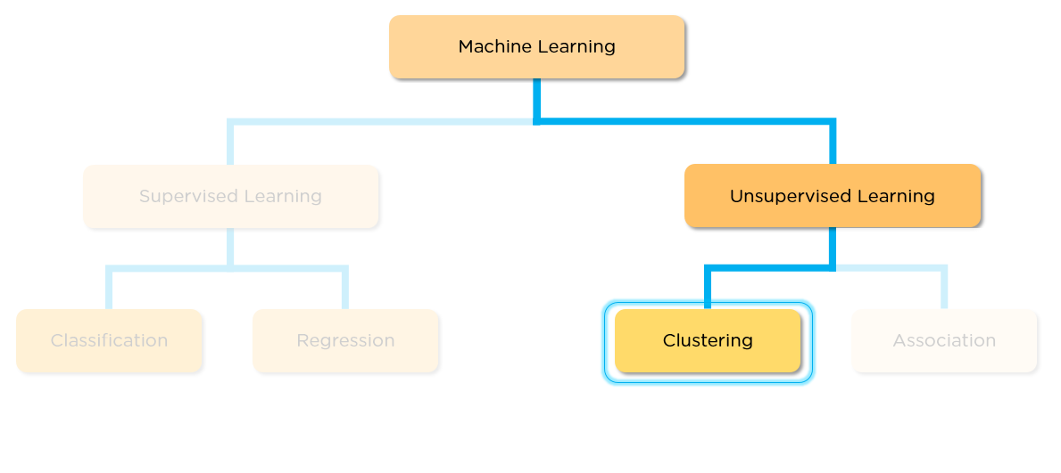

Slide 4
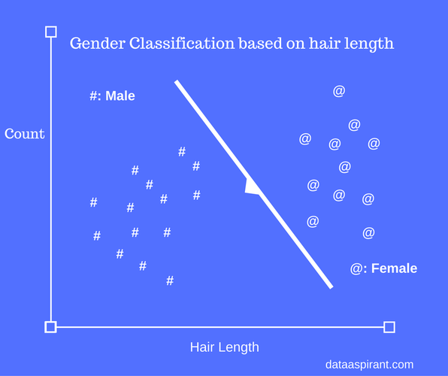
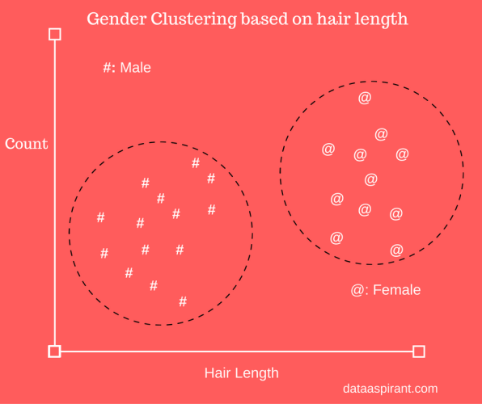

Slide 5
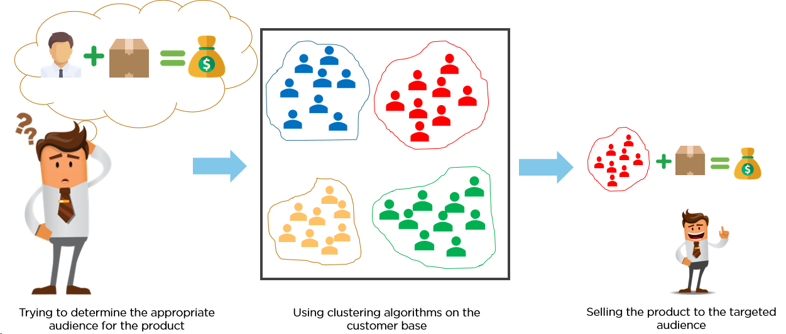

Slide 6
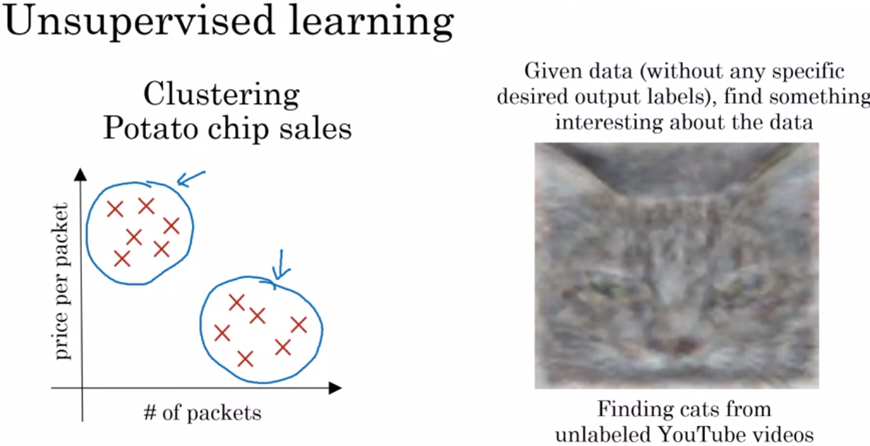

Slide 7
What is Cluster Analysis?
Cluster: A collection of data objects
  similar (or related) to one another within the same group
  dissimilar (or unrelated) to the objects in other groups
Cluster analysis (or clustering, data segmentation, …)
  Finding similarities between data according to the characteristics found in the data and grouping similar data objects into clusters
Unsupervised learning: no predefined classes (i.e., learning by observations vs. learning by examples: supervised)
Typical applications
  As a stand-alone tool to get insight into data distribution
  As a preprocessing step for other algorithms

Slide 8
Clustering for Data Understanding and Applications
Biology: taxonomy of living things: kingdom, phylum, class, order, family, genus and species
Information retrieval: document clustering
Land use: Identification of areas of similar land use in an earth observation database
Marketing: Help marketers discover distinct groups in their customer bases, and then use this knowledge to develop targeted marketing programs
City-planning: Identifying groups of houses according to their house type, value, and geographical location
Earth-quake studies: Observed earth quake epicenters should be clustered along continent faults
Climate: understanding earth climate, find patterns of atmospheric and ocean
Economic Science: market resarch

Slide 9
Clustering as a Preprocessing Tool (Utility)
Summarization:
  Preprocessing for regression, PCA, classification, and association analysis
Compression:
  Image processing: vector quantization
Finding K-nearest Neighbors
  Localizing search to one or a small number of clusters
Outlier detection
  Outliers are often viewed as those “far away” from any cluster

Slide 10
Quality: What Is Good Clustering?
A good clustering method will produce high quality clusters
  high intra-class similarity: cohesive within clusters
  low inter-class similarity: distinctive between clusters
The quality of a clustering method depends on
  the similarity measure used by the method
  its implementation, and
  Its ability to discover some or all of the hidden patterns

Slide 11
Measure the Quality of Clustering
Dissimilarity/Similarity metric
  Similarity is expressed in terms of a distance function, typically metric: d(i, j)
  The definitions of distance functions are usually rather different for interval-scaled, boolean, categorical, ordinal ratio, and vector variables
  Weights should be associated with different variables based on applications and data semantics
Quality of clustering:
  There is usually a separate “quality” function that measures the “goodness” of a cluster.
  It is hard to define “similar enough” or “good enough”
    The answer is typically highly subjective

Slide 12
Considerations for Cluster Analysis
Partitioning criteria
  Single level vs. hierarchical partitioning (often, multi-level hierarchical partitioning is desirable)
Separation of clusters
  Exclusive (e.g., one customer belongs to only one region) vs. non-exclusive (e.g., one document may belong to more than one class)
Similarity measure
  Distance-based (e.g., Euclidian, road network, vector) vs. connectivity-based (e.g., density or contiguity)
Clustering space
  Full space (often when low dimensional) vs. subspaces (often in high-dimensional clustering)

Slide 13
Requirements and Challenges
Scalability
  Clustering all the data instead of only on samples
Ability to deal with different types of attributes
  Numerical, binary, categorical, ordinal, linked, and mixture of these
Constraint-based clustering
    User may give inputs on constraints
    Use domain knowledge to determine input parameters
Interpretability and usability
Others
  Discovery of clusters with arbitrary shape
  Ability to deal with noisy data
  Incremental clustering and insensitivity to input order
  High dimensionality

Slide 14
Major Clustering Approaches (I)
Partitioning approach:
  Construct various partitions and then evaluate them by some criterion, e.g., minimizing the sum of square errors
  Typical methods: k-means, k-medoids, CLARANS
Hierarchical approach:
  Create a hierarchical decomposition of the set of data (or objects) using some criterion
  Typical methods: Diana, Agnes, BIRCH, CAMELEON
Density-based approach:
  Based on connectivity and density functions
  Typical methods: DBSACN, OPTICS, DenClue
Grid-based approach:
  based on a multiple-level granularity structure
  Typical methods: STING, WaveCluster, CLIQUE

Slide 15
Major Clustering Approaches (II)
Model-based:
  A model is hypothesized for each of the clusters and tries to find the best fit of that model to each other
  Typical methods: EM, SOM, COBWEB
Frequent pattern-based:
  Based on the analysis of frequent patterns
  Typical methods: p-Cluster
User-guided or constraint-based:
  Clustering by considering user-specified or application-specific constraints
  Typical methods: COD (obstacles), constrained clustering
Link-based clustering:
  Objects are often linked together in various ways
  Massive links can be used to cluster objects: SimRank, LinkClus

Slide 16
Chapter 10. Cluster Analysis: Basic Concepts and Methods
Cluster Analysis: Basic Concepts
Partitioning Methods
Hierarchical Methods
Density-Based Methods
Grid-Based Methods
Evaluation of Clustering
Summary

Slide 17

Partitioning Algorithms: Basic Concept
Partitioning method: Partitioning a database D of n objects into a set of k clusters, such that the sum of squared distances is minimized (where c_{i} is the centroid or medoid of cluster C_{i})
Given k, find a partition of k clusters that optimizes the chosen partitioning criterion
  Global optimal: exhaustively enumerate all partitions
  Heuristic methods: k-means and k-medoids algorithms
  k-means (MacQueen’67, Lloyd’57/’82): Each cluster is represented by the center of the cluster
  k-medoids or PAM (Partition around medoids) (Kaufman & Rousseeuw’87): Each cluster is represented by one of the objects in the cluster

Slide 18
The K-Means Clustering Method
Given k, the k-means algorithm is implemented in four steps:
  Partition objects into k nonempty subsets
  Compute seed points as the centroids of the clusters of the current partitioning (the centroid is the center, i.e., mean point, of the cluster)
  Assign each object to the cluster with the nearest seed point
  Go back to Step 2, stop when the assignment does not change

Slide 19

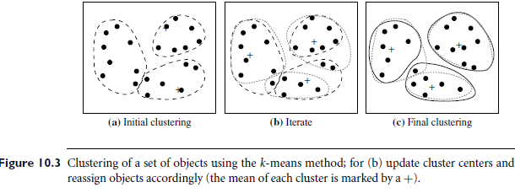

Slide 20





An Example of K-Means Clustering
K=2
Arbitrarily partition objects into k groups
Update the cluster centroids
The initial data set
Loop if needed
Reassign objects
Partition objects into k nonempty subsets
Repeat
  Compute centroid (i.e., mean point) for each partition
  Assign each object to the cluster of its nearest centroid
Until no change
Update the cluster centroids

Slide 21
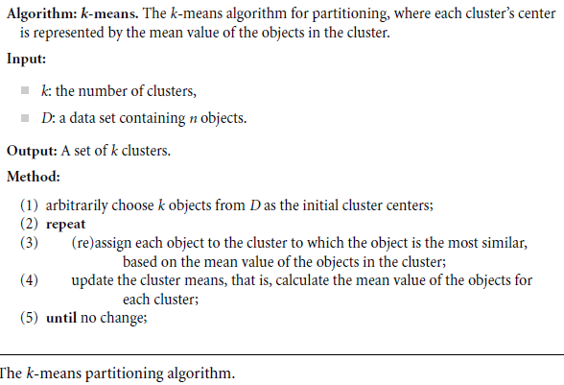

Slide 22
Example
i | X1 | X2
A | 1 | 1
B | 1 | 0
C | 0 | 2
D | 2 | 4
E | 3 | 5
Use K=2, Suppose A and C are randomly selected initial Means

Slide 23
https://www.youtube.com/watch?v=mtkWR8sx0NA
http://mnemstudio.org/clustering-k-means-example-1.htm

Slide 24
Exercise
Cluster the following 1-d data by k-means
1,2,4,8,9,10
Let k=2, and initial seeds are 1 and 4,

Slide 25
Comments on the K-Means Method
Strength: Efficient: O(tkn), where n is # objects, k is # clusters, and t is # iterations. Normally, k, t << n.
    Comparing: PAM: O(k(n-k)² ), CLARA: O(ks² + k(n-k))
Comment: Often terminates at a local optimal.
Weakness
  Applicable only to objects in a continuous n-dimensional space
    Using the k-modes method for categorical data
    In comparison, k-medoids can be applied to a wide range of data
  Need to specify k, the number of clusters, in advance (there are ways to automatically determine the best k (see Hastie et al., 2009)
  Sensitive to noisy data and outliers
  Not suitable to discover clusters with non-convex shapes

Slide 26

Variations of the K-Means Method
Most of the variants of the k-means which differ in
  Selection of the initial k means
  Dissimilarity calculations
  Strategies to calculate cluster means
Handling categorical data: k-modes
  Replacing means of clusters with modes
  Using new dissimilarity measures to deal with categorical objects
  Using a frequency-based method to update modes of clusters
  A mixture of categorical and numerical data: k-prototype method

Slide 27
What Is the Problem of the K-Means Method?
The k-means algorithm is sensitive to outliers !
  Since an object with an extremely large value may substantially distort the distribution of the data
K-Medoids: Instead of taking the mean value of the object in a cluster as a reference point, medoids can be used, which is the most centrally located object in a cluster
10
10
9
9
8
8
7
7
6
6
5
5
4
4
3
3
2
2
1
1
0
0
1
2
3
4
5
6
7
8
9
10
0
0
1
2
3
4
5
6
7
8
9
10

Slide 28

PAM: A Typical K-Medoids Algorithm
Total Cost = 20
10
9
8
Arbitrary choose k object as initial medoids
Assign each remaining object to nearest medoids
7
6
5
4
3
2
1
0
0
1
2
3
4
5
6
7
8
9
10
K=2
Randomly select a nonmedoid object,O_{ramdom}
Total Cost = 26
Do loop
Until no change
10
10
9
Compute total cost of swapping
9
Swapping O and O_{ramdom}
If quality is improved.
8
8
7
7
6
6
5
5
4
4
3
3
2
2
1
1
0
0
1
2
3
4
5
6
7
8
9
10
0
0
1
2
3
4
5
6
7
8
9
10

Slide 29
The K-Medoid Clustering Method
K-Medoids Clustering: Find representative objects (medoids) in clusters
  PAM (Partitioning Around Medoids, Kaufmann & Rousseeuw 1987)
    Starts from an initial set of medoids and iteratively replaces one of the medoids by one of the non-medoids if it improves the total distance of the resulting clustering
    PAM works effectively for small data sets, but does not scale well for large data sets (due to the computational complexity)
Efficiency improvement on PAM
  CLARA (Kaufmann & Rousseeuw, 1990): PAM on samples
  CLARANS (Ng & Han, 1994): Randomized re-sampling

Slide 30
Chapter 10. Cluster Analysis: Basic Concepts and Methods
Cluster Analysis: Basic Concepts
Partitioning Methods
Hierarchical Methods
Density-Based Methods
Grid-Based Methods
Evaluation of Clustering
Summary

Slide 31
Hierarchical Clustering
Use distance matrix as clustering criteria. This method does not require the number of clusters k as an input, but needs a termination condition
Step 0
Step 1
Step 2
Step 3
Step 4
agglomerative
(AGNES)
a
a b
b
a b c d e
c
c d e
d
d e
e
divisive
(DIANA)
Step 4
Step 3
Step 2
Step 1
Step 0

Slide 32

AGNES (Agglomerative Nesting)
Introduced in Kaufmann and Rousseeuw (1990)
Implemented in statistical packages, e.g., Splus
Use the single-link method and the dissimilarity matrix
Merge nodes that have the least dissimilarity
Go on in a non-descending fashion
Eventually all nodes belong to the same cluster

Slide 33
Dendrogram: Shows How Clusters are Merged
  Decompose data objects into a several levels of nested partitioning (tree of clusters), called a dendrogram
  A clustering of the data objects is obtained by cutting the dendrogram at the desired level, then each connected component forms a cluster

Slide 34
Hierarchical Clustering
https://vimeo.com/109636143
https://www.youtube.com/watch?v=rg2cjfMsCk4

Slide 35
Data Mining:
Concepts and Techniques
(3rd ed.)
— Chapter 10 —
Jiawei Han, Micheline Kamber, and Jian Pei
University of Illinois at Urbana-Champaign &
Simon Fraser University
©2011 Han, Kamber & Pei. All rights reserved.

